Slide 1
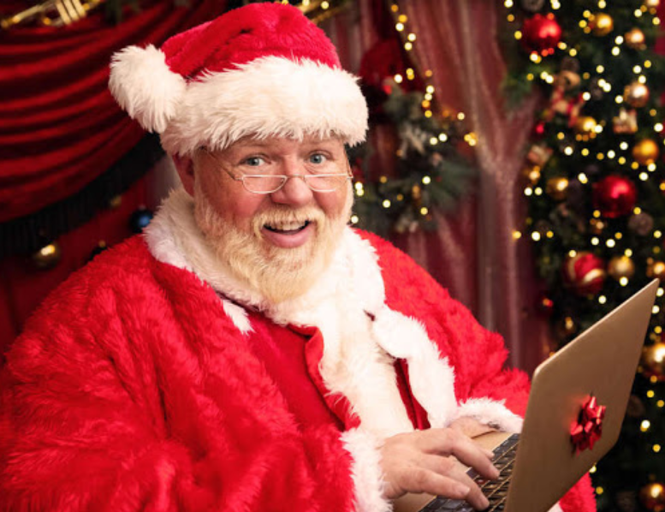
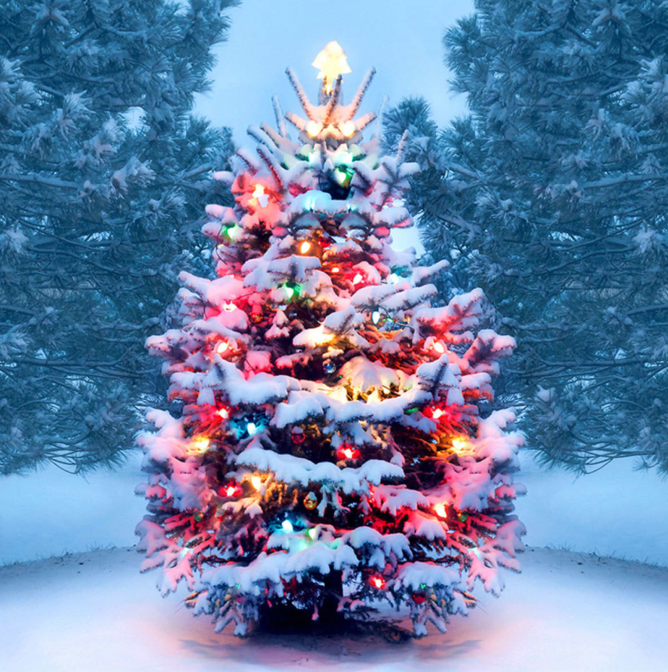
Christmas Tree Ho Ho Ho!
Jonathan D’Costa

Slide 2
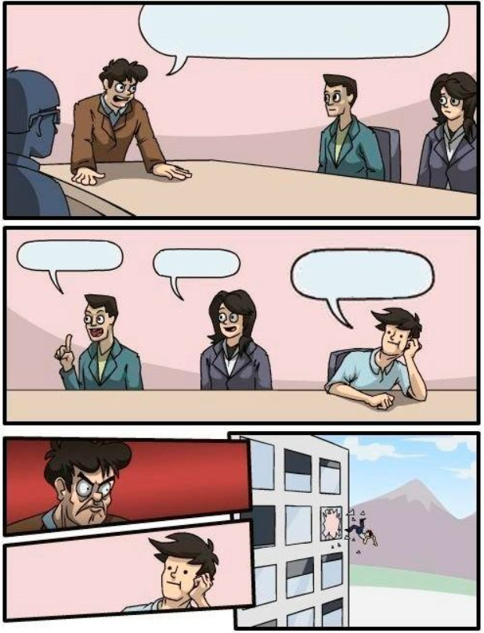

Christmas Tree
Ideas? Speak up!!
What is the first thing that comes to your mind?
Celebration, party time
Family and friends
Jingle Bells
Gifts
What did I use it for?
To keep sane!
Food
Parties
Sanity

Slide 3
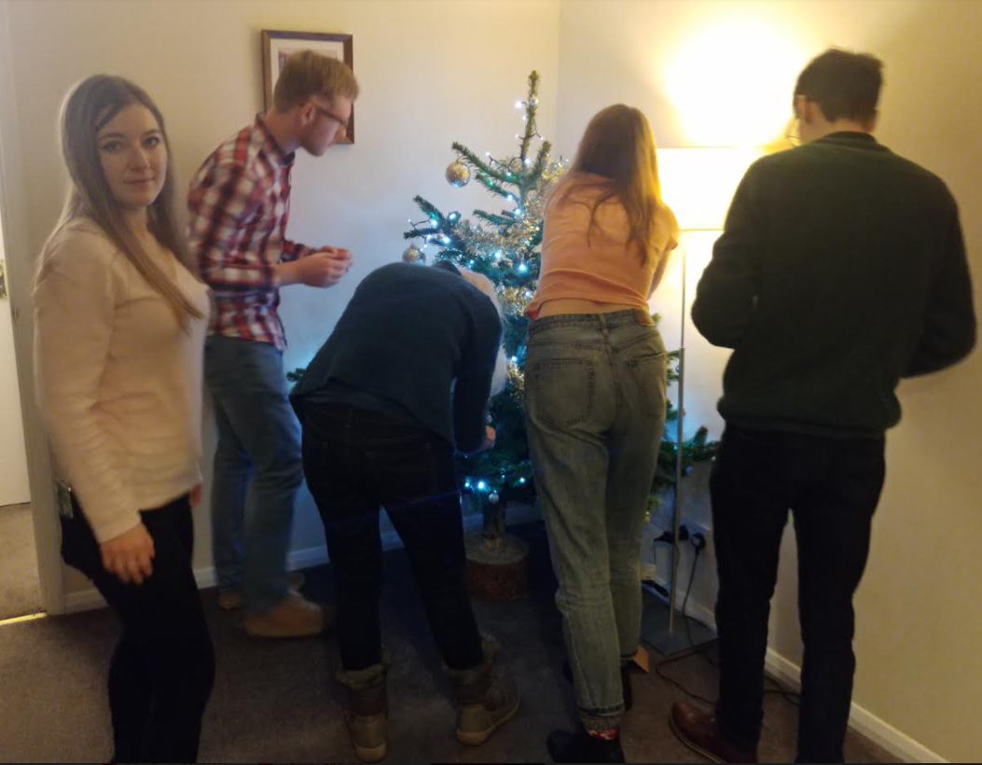
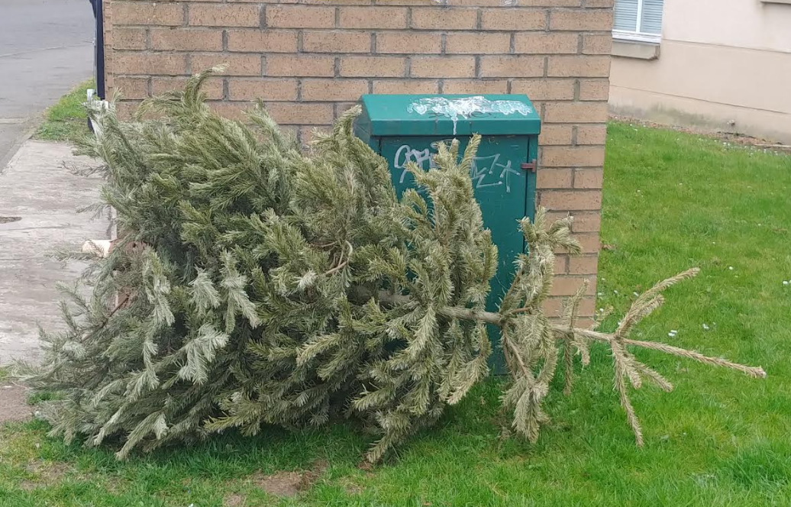
Pudding is in the Poof

Slide 4
Thank You
Ho Ho Ho!

